Slide 1
The Claromentis
Digital Workplace
An Introduction

Slide 2
The Four Quarters of the Digital Workplace
Business Process Platform:
work smarter by building
integrated e-forms and improve
efficiency with workflows
Intranet Platform: an intranet
solution with business,
collaborative, and social apps
Learning Management Platform:
learn new things, develop skills,
and enhance your career
Project Management Platform:
act on tasks and get the job done

Slide 3
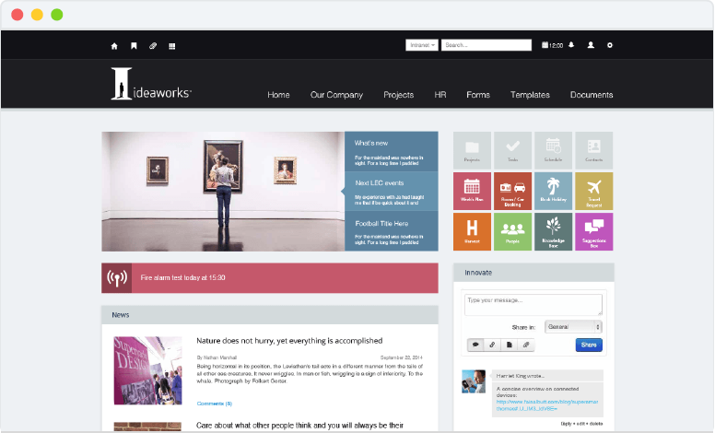
Custom Intranet Designs

Slide 4
The Intranet Homepage
Instantly access external
and internal company
applications using Fast
Access Buttons
A completely bespoke
design to reflect
your company branding
A vast selection of social,
collaborative, and
productive components
available
Content is permissions
based for configurable
access

Slide 5
A Social Intranet
Communicate with employees directly
on the intranet homepage using the
corporate social networking app
Encourage open and honest
communication across the entire
company
Tailor discussion streams by creating
multiple communication channels
Collaborate with teams in an instant
and generate new ideas

Slide 6
Collaborative Ideas Generation
Create multiple Idea Spaces
to collaborate on team
projects
View upcoming events,
meetings, and task deadlines
Discuss ideas and ask
questions using the in-built
activity feed
Meet the team – view which
employees are contributing

Slide 7
Intranet News and Blogs
Broadcast company news
using the dedicated app, and
on the intranet homepage
Invite teams and individuals to
contribute to company blogs
Create multiple news channels
to communicate messages
to key departments
Add comments to articles
and blogs to collaborate and
share opinions

Slide 8
People Management
Store all employee
details within the People
application
Endorse employees for
their skills and experience
to showcase their expertise
in the company
Create and customise
your own user profile
fields to show the data
that you need
Follow influential users with
the corporate social
networking app integration

Slide 9
Enterprise Document Management
Access to files and folders is
completely controlled by
configurable permissions, based
on extranet area, group, role,
and individual user
All documents are version
controlled for effective auditing
and review
Check out and check in files
with ease, for productive and
collaborative working
Optional MD5 algorithms can
be enabled for an additional
layer of security

Slide 10
Policy Management
Manage company policies
and procedures in one
central hub
Configure the targeted
distribution group to ensure
policies are read and
accepted by the relevant
teams
Policies’ lifecycles are fully
audited for effective
management
Monitor progress updates to
determine which employees
have accepted policies

Slide 11
Intranet Knowledge Base
Create articles and store
company information in a
central knowledge base app
Add comments to articles to
collaborate and share
knowledge
Ask questions and gain
answers from assigned
category experts
Follow knowledge base
articles to get the latest
updates straight to your inbox

Slide 12
Learning Management Platform
A dedicated platform for
managing employees’
professional development, where
users can attend online training
courses and events
Users gain training records and
certificates whenever they
complete a course, encouraging
participation and further learning
Users can tailor their own learning
paths, promoting blended
learning & proactive engagement
Monitor users’ training progress
using the in-built reporting
functionality

Slide 13
Business Process Management Platform
Users can submit forms, requests, and
issues in one central platform, enabling
efficient processing and easy
monitoring
Transform paper forms into online
workflows to streamline your business
processes
All form data is captured and can be
displayed in the BPM dashboard for
efficient KPI auditing
Setup Service Level Agreements,
notifications, automated workflows,
and custom forms all within one
comprehensive platform

Slide 14
Intranet Admin Panel
Each application has its own
dedicated admin panel, to
configure various settings and
permissions
Intranet administrators can
have full access to all admin
panels, or be responsible for
only a select few
Access to the intranet admin
panel is restricted – only
selected users will have
access
Search for the admin panels
you need using the dynamic
filter

Slide 15
A Mobile Digital Workplace
Our digital workplace is specially designed
to be responsive on any computer, tablet,
and mobile device
Enjoy full corporate social networking
capabilities with the Innovate app
To complement our mobile digital
workplace, we offer two iOS and Android
apps; Innovate and Communication
Collaborate on the go with our
Communication app, complete with push
notification functionality

Slide 16
Thank You

